Slide 1
Complex welfare services in Nordic countries
Nordic network on complex welfare services, 2023–2025

Slide 2

Agenda
The context for the mapping
Five findings in the cross-Nordic welfare
Approaches to holistic welfare services
About the Nordic network on complex welfare services

Slide 3

The context for
the mapping

Slide 4

The context for the mapping
Contributes to Vision 2030 and the strategic review of Nordic social cooperation
Vision 2030: most sustainable and integrated region; a green, competitive and socially sustainable Nordic region
Strategic review of social services (Árni Páll Árnason): when no one has holistic responsibility, people risk not receiving needed help → need to build bridges across sectors
Builds on VIVE (2021) comparative analysis of organisation of the social field (authority, operational and financing responsibilities; specialisation and professional management)

Slide 5
The context for the mapping
The most difficult social challenges cannot be solved within a single sector.
“
– Árni Páll Árnason

Slide 6

Five findings in
the cross-Nordic welfare

Slide 7



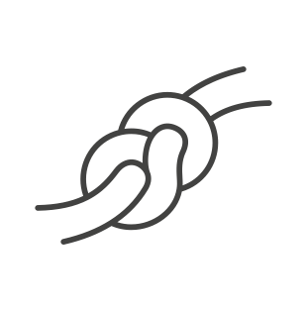

Five findings in the cross-Nordic welfare
The overall welfare needs of the individual citizen tend to receive insuffi-cient attention
Competence strategies are often under-developed
Incentive struc-tures provide limited support for prioritisation of coordinated services
Lack of respon-sibility and shared owner-ship can make coordination challenging
A guidance overload can create deman-ding conditions for (de)imple-mentation

Slide 8
The overall welfare needs of the individual tend to receive insufficient attention
Five findings in the cross-Nordic welfare
Lack of coordination/collaboration → fragmented processes; repeating their story; uncertainty about responsibilities; standardised services not adapted to individual situations
Services often rigid and diagnosis-centred; actors lack a common plan and work independently → inefficient use of resources; contradictory or incomplete solutions
How one talks about user groups affects all system levels (e.g., avoiding narratives that frame persons as a “burden on society”)

Slide 9
Competence strategies are often underdeveloped
Five findings in the cross-Nordic welfare
Difficulty recruiting necessary skills (employees and managers); need both generalist and specialist competences
Increasing specialisation increases the need for collaboration; providers may avoid collaboration due to time/resources → managing complexity requires special management skills
There is a lack of comprehensive competence strategies, as well as insufficient structures and capacity to support initiatives aimed at developing and implementing such strategies

Slide 10
Incentive structures provide limited support for prioritisation of coordinated services
Five findings in the cross-Nordic welfare
Financial considerations and budget restrictions prioritised over professionalism; sectors defend their own budgets → “sow-and-reap problem”
Desire for short-term visible results can conflict with long-term strategic plans → measures risk being populist rather than necessary

Slide 11
Lack of responsibility and shared owner-ship can make coordination challenging
Five findings in the cross-Nordic welfare
Lack of management support and unclear goals → employees feel solely responsible; no one takes responsibility for overall coordination
Lack of overview across services and authorities; unclear who does what and what resources/competences exist; difficult to integrate services to meet complex needs
Siloed organisation at municipal and national levels; “isolated islands”; lack of strategic leadership across silos
Differing governance mechanisms, sectoral logics and legislative levels; sectoral pressures lead to uncoordinated solutions; front-line operations bear the burden when cross-sectoral issues aren’t solved nationally

Slide 12
A guidance overload can create demanding conditions for (de)implementation
Five findings in the cross-Nordic welfare
Continuous pressure from new, sector-specific and sometimes contradictory national requirements → “change fatigue” and cross-sector collaboration challenges; difficult to “oblige municipalities with anything other than their good will”
Resource limitations force prioritisation; rarely stated what to de-implement when new guidance is introduced
If guidance is too general, it becomes “fluffy”; if too specific it’s hard to apply across sectors; differing professional languages complicate cooperation

Slide 13
“
Five findings in the cross-Nordic welfare
Despite differences in legislation and organisation, the Nordic countries face a remarkably similar set of challenges

Slide 14
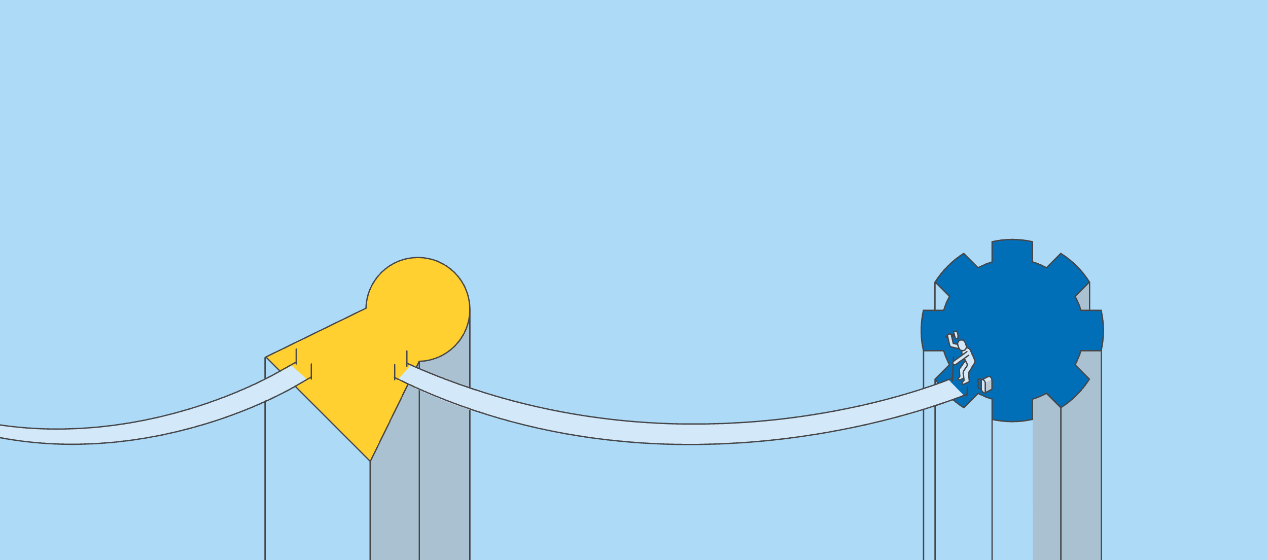
Approaches to holistic welfare services

Slide 15
Strengthen national and local coordination and cooperation by
Approaches to holistic welfare services
Approaches at the national level
Build a common language and knowledge base by
Implementing a national strategy with shared goals and roles across sectors
Establishing arenas for cross-sectoral and strategic dialogue
Developing cooperation models between municipalities, regions, and authorities
Developing a shared conceptual framework (e.g. dictionary)
Publishing long-term forecasts, indicators, and comprehensive guidelines
Sharing effective initiatives and cooperation models via digital platforms
Providing multilingual guidance on the welfare system, individual rights and support access

Slide 16
Coordinate government signals and requirements by
Approaches to holistic welfare services
Approaches at the national level
Coordinating and prioritise state-level requirements and expectations to avoid contradictions
Developing support for implementation and what to phase out
Establishing arenas where state and municipalities agree on goals, roles and priorities focused on user needs
Offering financial incentives and long-term support for interdisciplinary municipal teams

Slide 17
Strengthen leadership for change and quality by
Approaches to holistic welfare services
Approaches at the local level
Prioritise cross-organisational collaboration, common goals, and support by
Anchoring coordination and competence development in strategic management promoting innovation and flexibility
Changing incentive structures and ensure coherence between citizen perspectives, strategic direction and methods for leadership
Ensuring cross-organisational and cross-disciplinary collaboration through shared goals and strong leadership
Building a shared mindset and strategic coherence at all management levels
Integrating coordination into management systems, budgets and strategies
Supporting long-term efforts with financing models, reward system, and clear responsibilities
Promoting shared understanding and experience exchange across meetings, network, and applicable tools
Fostering a culture of trust, openness and respect for professional skills
Strengthening collaboration with joint plans, follow-ups, and tools for coordination and dialogue

Slide 18
Ensure strategic competence development and professional support by
Approaches to holistic welfare services
Approaches at the local level
Place the user perspective at the centre by
Developing long-term competence plan for both employees and managers
Prioritising broad competences, continuing education, and specialised support
Supporting professional development through interdisciplinary supervision, sparring, and collegial communities
Establishing regional networks and arenas for reflection, learning and sharing across disciplines and levels
Promoting interdisciplinary cooperation to ensure better solutions for citizens and families
Integrating the user perspective into management systems, strategies and practices
Using participatory methods that give citizens real influence
Creating arenas for citizen voices in both system design and individual cases
Providing services based on citizens’ overall needs, goals, and life situation
Engaging citizens through trust, co-ownership, accessibility, and coherent plans
Reducing contact points creating coherence across departments

Slide 19

Approaches to holistic welfare services
Key takeaways
The Nordic countries face a very similar set of challenges despite different systems
There is a need for common Nordic perspectives and innovative approaches, and a platform to address complex issues across borders

Slide 20

About the Nordic network on complex welfare services

Slide 21
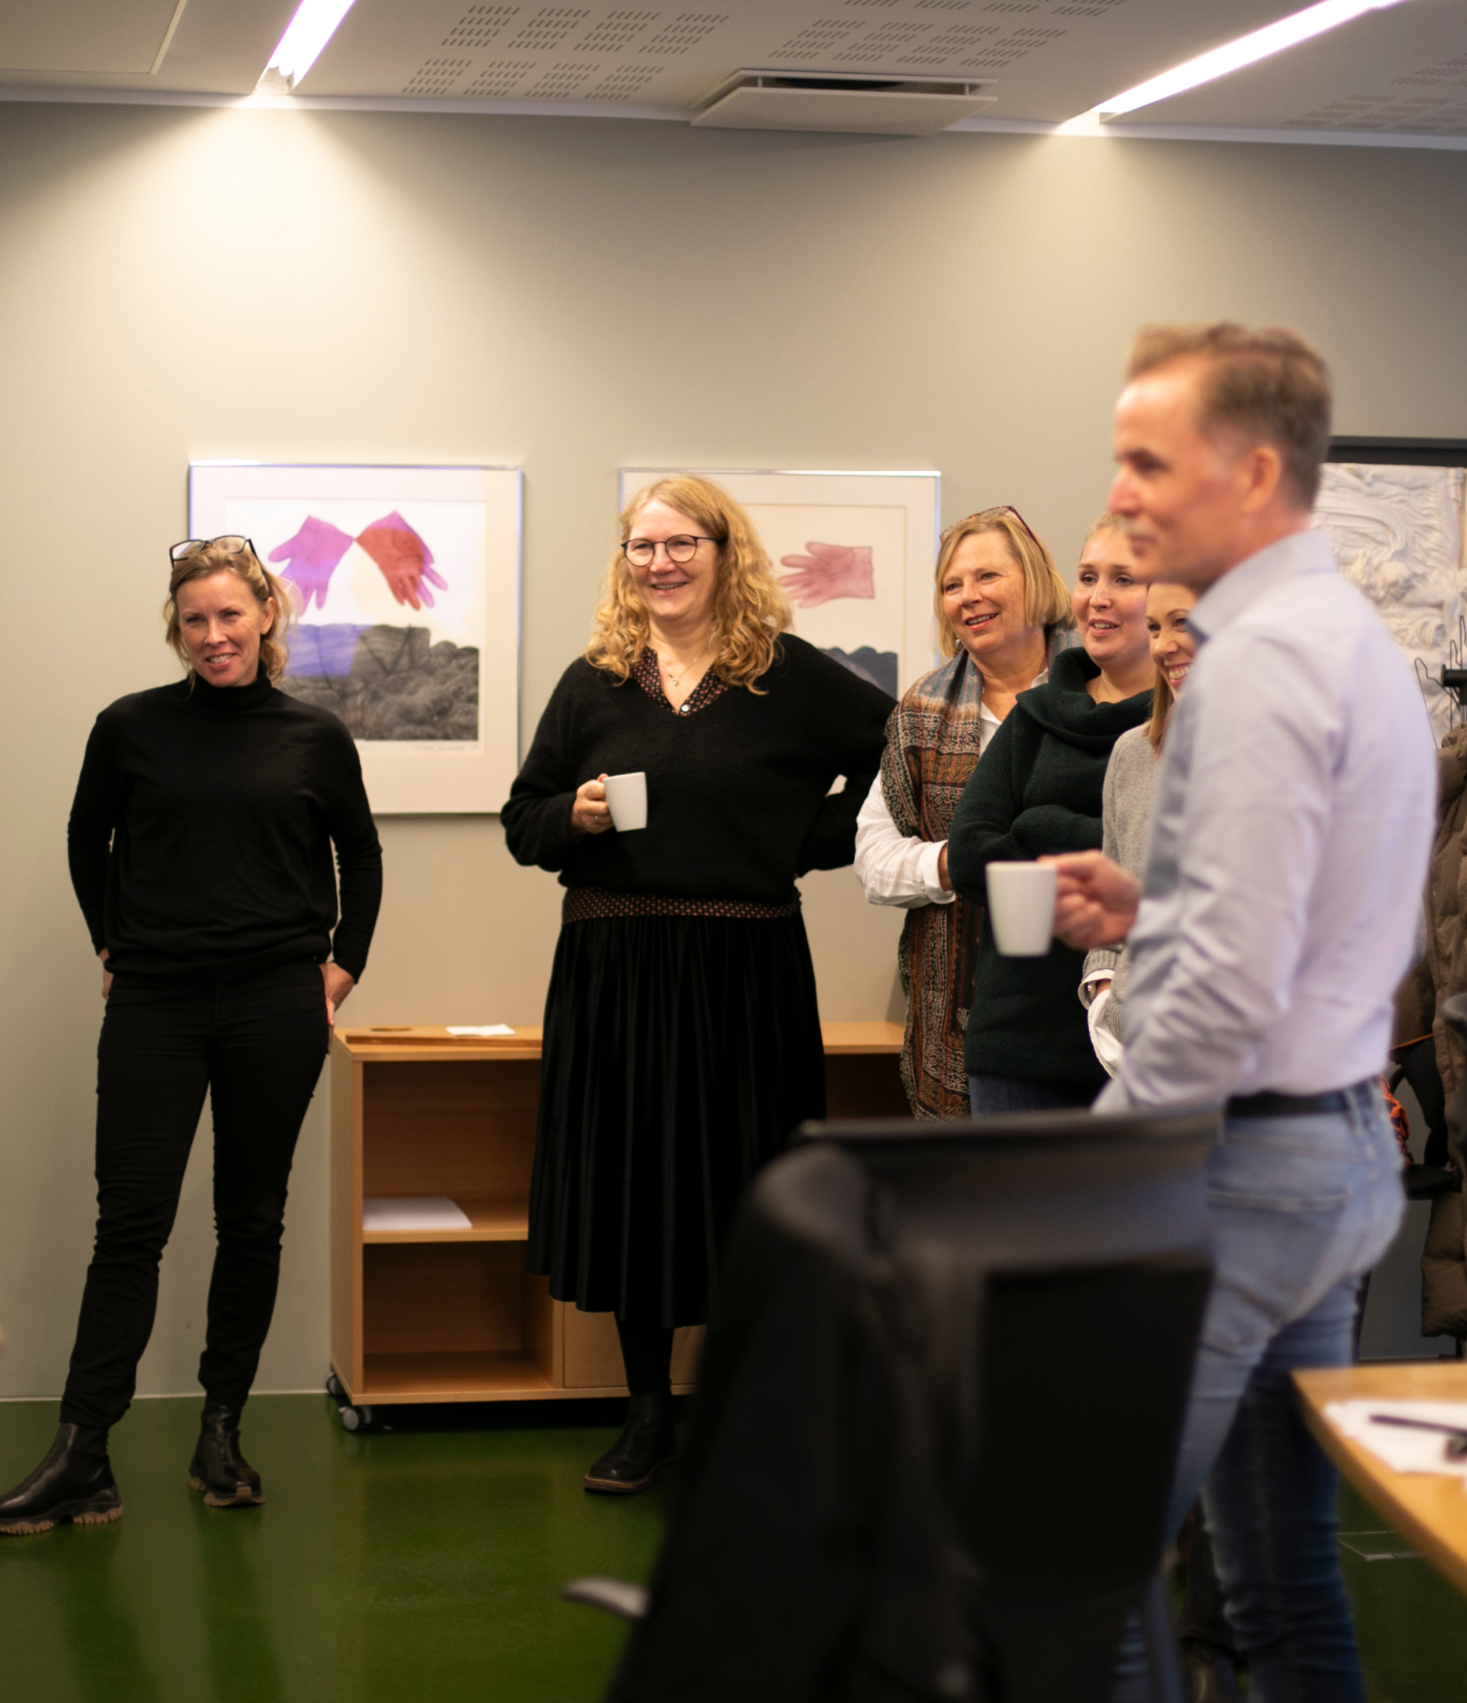
About the Nordic network on complex welfare services
Nordic Council of Ministers
An arena for government actors in the Nordic countries for reflection, discussion and knowledge sharing on structuring and coordinating efforts faced with wicked problems
Target group: users of welfare services with complex needs – regardless of age and diagnosis
Discussions based on a user perspective; main challenge concerns organisation, responsibility, coordination and cooperation across state, regions, municipalities and other public actors
Supported by the Nordic Council of Ministers (2023–2025)
Photo Anja Bergersen

Slide 22
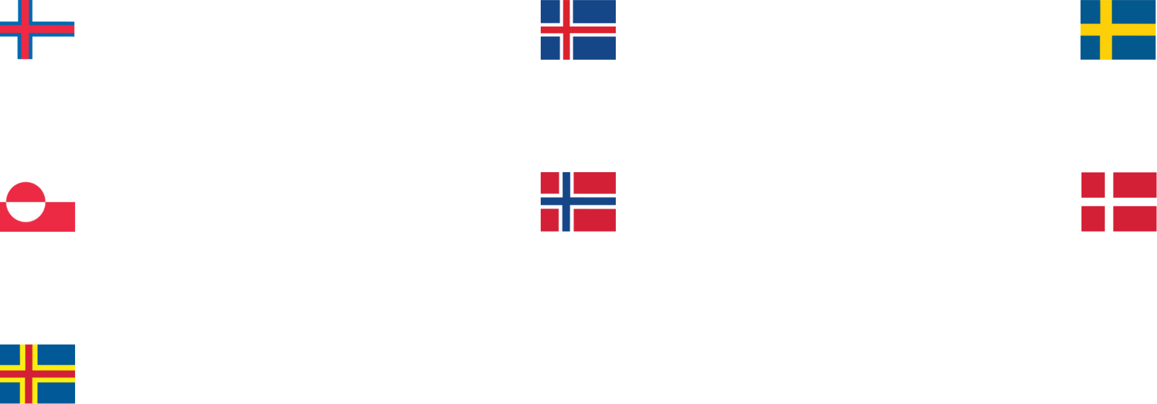
Members of the Nordic network on complex welfare services
About the Nordic network on complex welfare services
Faroe Islands
The Department of Social Services
Iceland
The Department of Social Affairs and Housing
Sweden
The National Board of Health and Welfare
Greenland
The National Board of Social Services
Norway
The Directorate for Children, Youth and Family Affairs
The Directorate of Labour and Welfare
The Directorate of Health
Denmark
The Danish Authority of Social Services and Housing
Åland
The Social and Environmental Department of Ålands Provincial Government

Slide 23

Thank you!

